Slide 1
Thursday, November 15th, 2018
Unit 6 THE FIRST UNIVERSITY
IN VIETNAM
LESSON 1 GETTING STARTED
Making arrangements for a trip

Slide 2
Answer the question: What would you like to take with you for a trip?
Next Slide

Slide 3
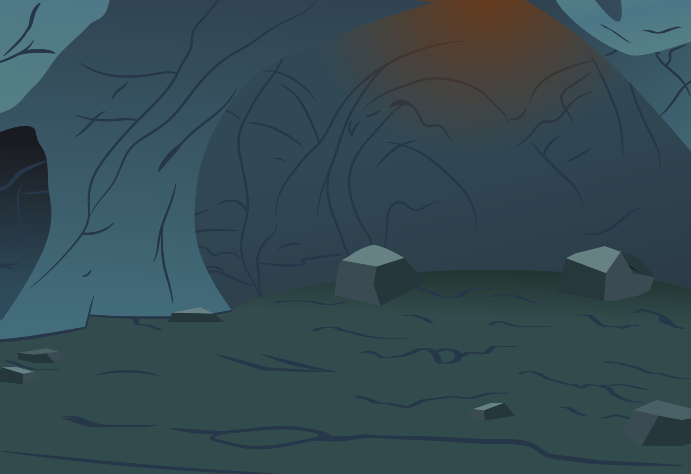

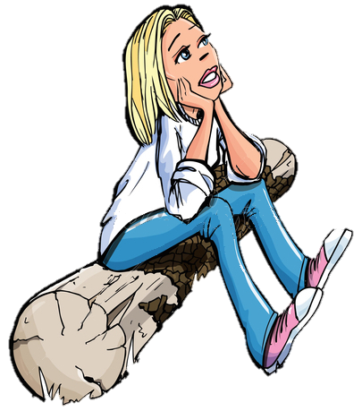


What are you going to do for a trip?
I’m going to take some photos with my …
CAMERA
HINT
CHECK

Slide 4
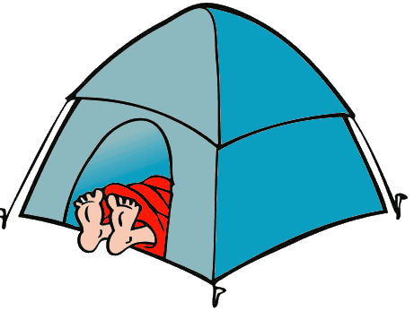
What are you going to do for a trip?
I’m going to rest in my …
TENT
HINT
CHECK

Slide 5
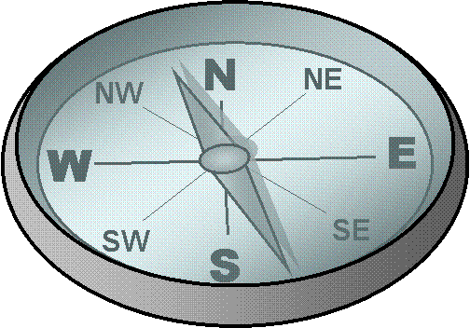
What are you going to do for a trip?
I’m going to find the way to the lake with my …
COMPASS
HINT
CHECK

Slide 6

What are you going to do for a trip?
I’m going to illuminate the way at night with my …
TORCH
HINT
CHECK

Slide 7
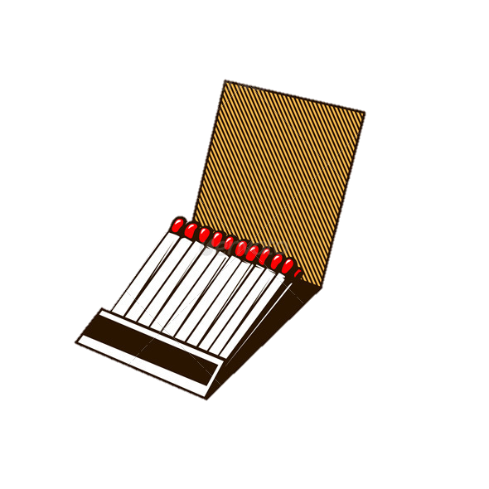
What are you going to do for a trip?
I’m going to light the fire with …
MATCHES
HINT
CHECK

Slide 8
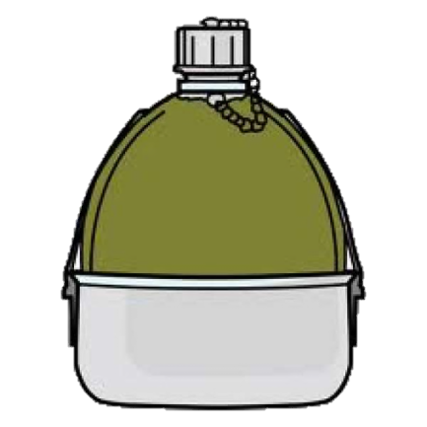
What are you going to do at the camp?
I’m going to drink …
Bottled water
HINT
CHECK

Slide 9
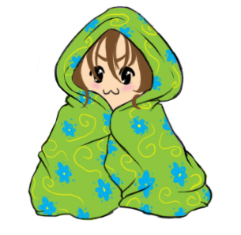
What are you going to do at the camp?
I’m going to be wrapped in my …
blanket
HINT
CHECK

Slide 10
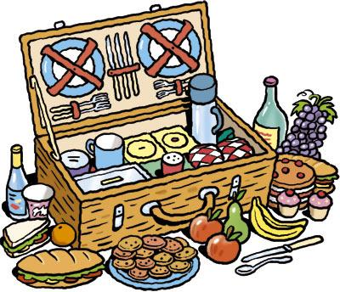
What are you going to do at the camp?
I’m going to take................… because I will be able to be hungry.
food
HINT
CHECK

Slide 11
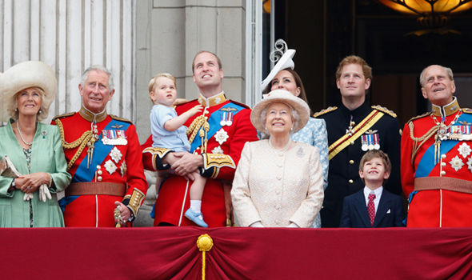

Vocabulary
imperial (adj)
/ɪmˈpɪəriəl/
The royal family/ the imperial family

Slide 12
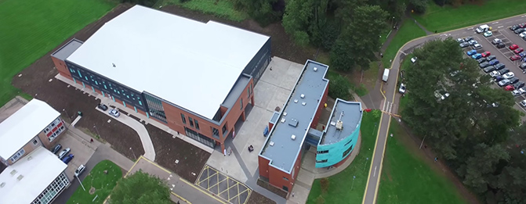
Vocabulary
academy (n)
/əˈkædəmi/
A school or a college for
special training
Ex: This is an academy of sport.

Slide 13
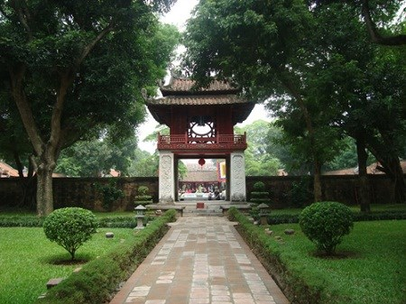
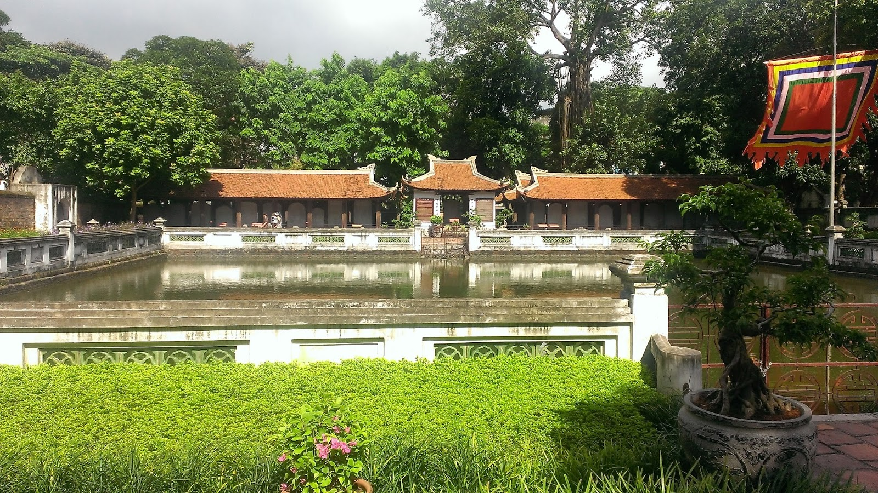
Vocabulary
Temple of Literature
And the Imperial Academy

Slide 14

Vocabulary
- imperial (adj):
Thuộc hoàng đế
- academy (n) :
Học viện
- Temple of Literature
and the Imperial Academy:
Văn Miếu Quốc Tử Giám

Slide 15
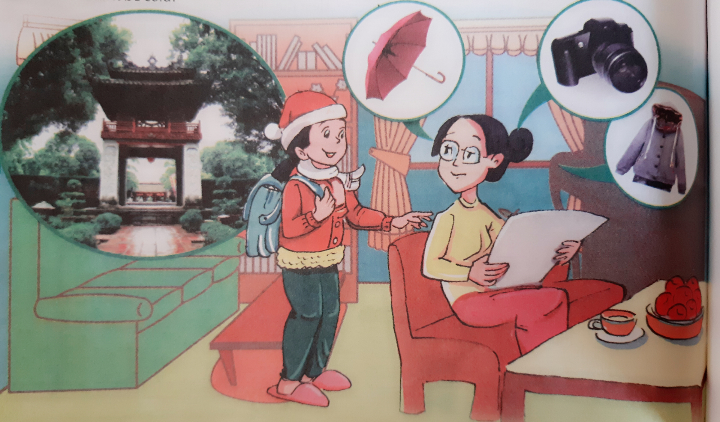

Slide 16
Mai’s mum: What are you doing, Mai?
Mai: I’m preparing for a trip to the Temple of Literature and the Imperial Acadamy.
Mai’s mum: Oh, I see. You know that it’s a famous historic and cultural place.
Mai: Of course, Mum.
Mai’s mum: Did you know that it was started in the 11th century? The Imperial Academy is considered the first university in Vietnam.
Mai: Yeah, we learned about that in school. Mum, this is the list of the things I plan to take with me.
Mai’s mum: Let me have a look. You definitely don’t need an umbrella. It’s winter and there’s not much rain.
Mai: Will it be cold?
Mai’s mum: Yes, it’s a good idea to take warm clothes.
Mai: I see.
Mai’s mum: The Temple of Literature is a beautiful place. It’s surrounded by trees and contains many interesting things. You’d better take the camera.
Mai: I will, Mum

Slide 17



ANGRY BIRDS
Mystery Box

Slide 18

THE RULES
Choose an egg and answer the question.
You have 5 seconds to answer.
If you give the incorrect answer, another team can raise their hands to answer.
If you get it right, you will get a MYSTERY BOX.
The mystery box is good or bad.
You can keep it or give it to another team.

Slide 19








MYSTERY BOX PRIZES
LOSE 100
GET 100
LOSE 200
GET 200
STEAL 100
LOSE 1/2
GET 500
LOSE ALL

Slide 20
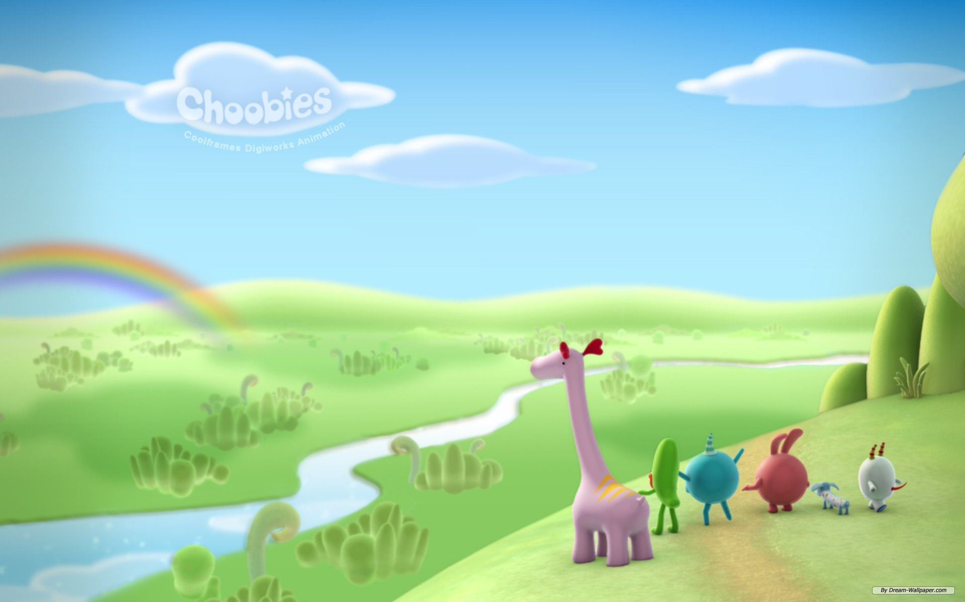






CHOOSE ONE
1
2
3
4
5
6

Slide 21

What is Mai going to visit?
LOSE 100
Give it
or
Keep it?
She is going to visit The Temple of Literature -The Imperial Academy.
H
O
M
E

Slide 22
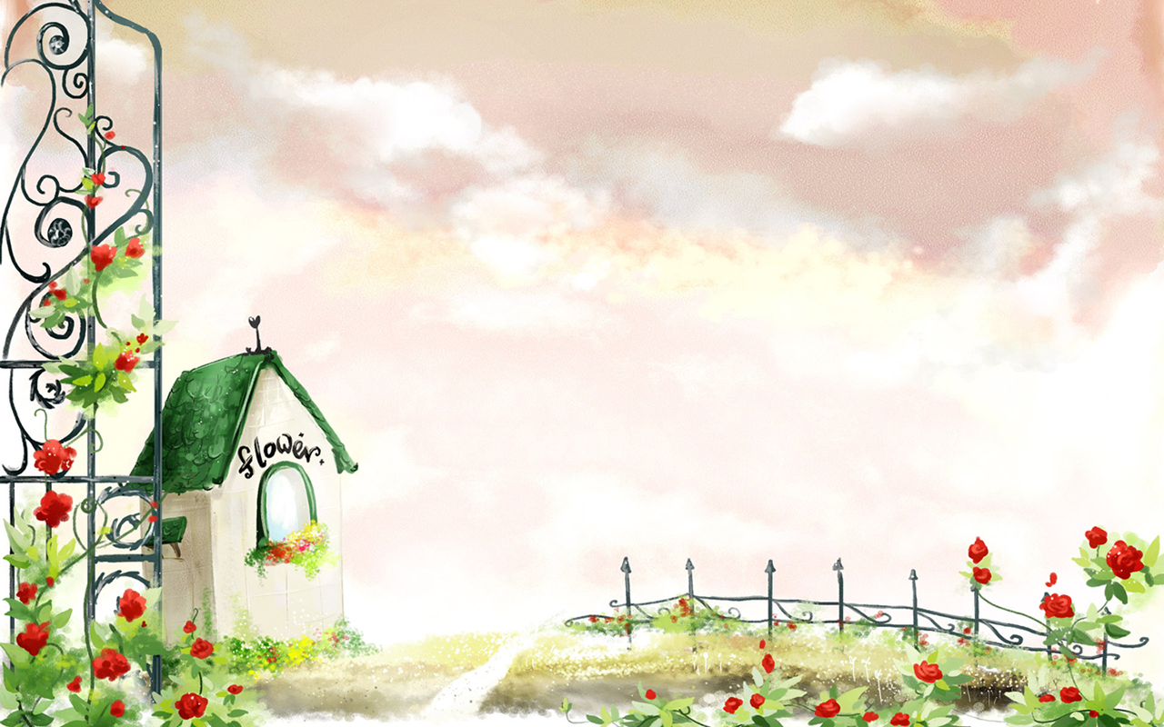
2. What is the Imperial Academy?
GET 200
Give it
or
Keep it?
It’s the first university in Vietnam.
H
O
M
E

Slide 23

3. When was it founded?
Give it
or
Keep it?
STEAL 100
About one thousand years ago/ in the 11th century.
H
O
M
E

Slide 24
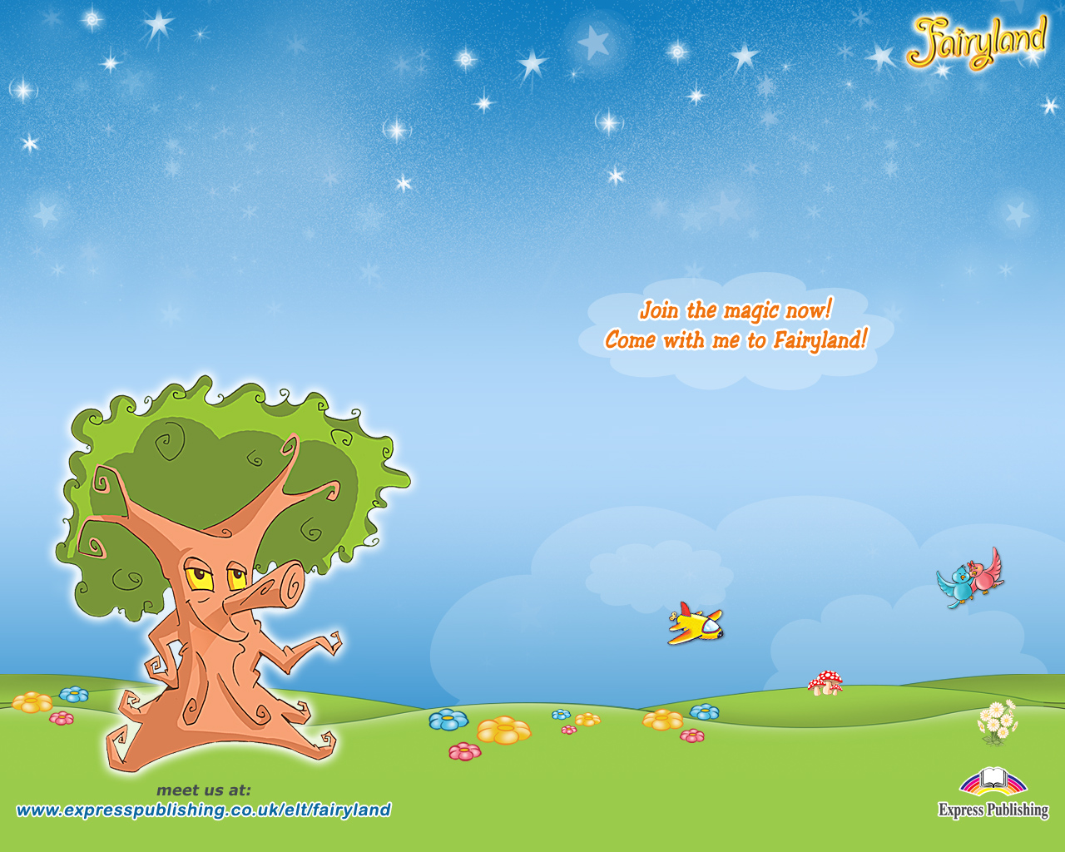
4. Where is it located?
GOLDEN EGG
GET 500
Give it
or
Keep it?
In the centre of Hanoi.
H
O
M
E

Slide 25
5. Why is Mai going to take warm clothes?
TERRIBLE PIG
LOSE ALL
Give it
or
Keep it?
Because it will be cold
H
O
M
E

Slide 26

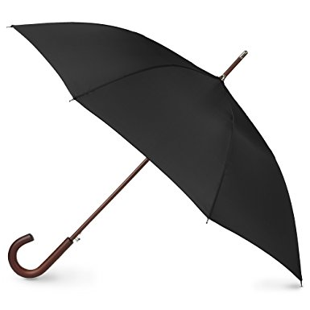
What’s this?
GET 100
Give it
or
Keep it?
umbrella
H
O
M
E

Slide 27
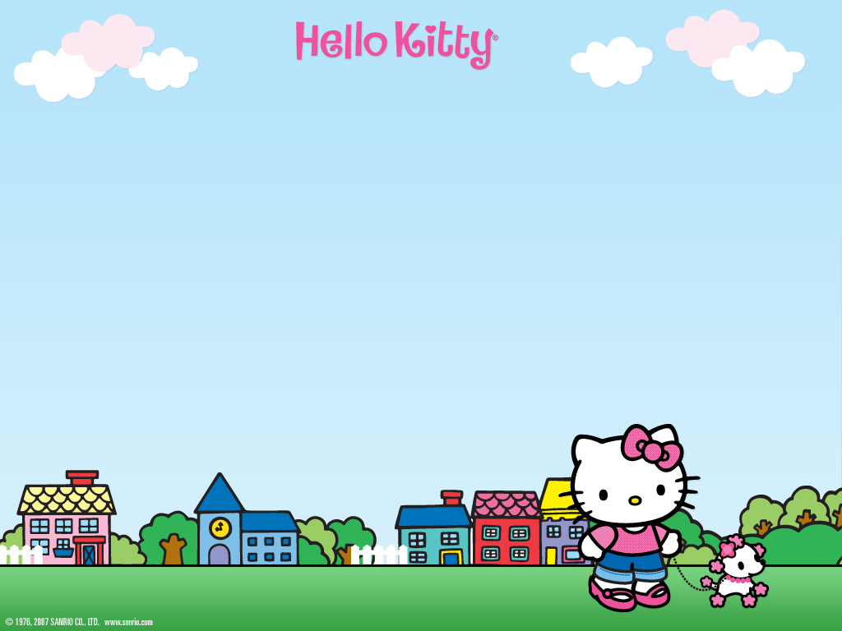
Read the conversation again. Complete the table.
Things Mai needs to take and reasons why | Things Mai doesn’t need to take and reasons why not
Warm clothes –
because it will be cold
An umbrella – because it is
winter and there
is not much rain.
The camera – because it contains
many interesting things so she can take photos.

Slide 28
2. Imagine that you are going to take a trip to a temple or a pagoda
a. Look at the table and tick (v) the items you would like to take with you
blanket | warm clothes
tent | bottled water
ball | umbrella
camere | mobile phone
food | compass
b. Work in pairs. Tell your partner about three of the items you would like to take with you for the trip and explain why. You can use the following suggestions
Example: I’ll take warm clothes because it’ll be cold.
I’ll need/ take________ because_______________.
I’d like to take_________ because______________.

Slide 29
c. work in pairs. Give advice to your partner about what to take and what not to take on the trip. Give reasons
Example: A: I want to take a trip to Sa Pa.
B: You’d better take warm clothes because it’s cold.
You’d better take _______________ because__________.
It’s a good idea to take ____________ because________.
You won’t need ______________because____________.
It’s not necessary to take___________because_________.

Slide 30
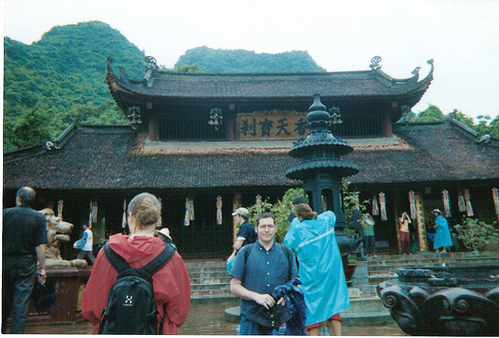
3. Imagine that your class is planning a trip to Huong Pagoda. Work in groups. Ask and answer questions about how to make arrangements for the trip. Then fill in the table.

Slide 31
When to go?
Who to go with?
Where to go?
Making arrangements for the trip to ………
How to get there?
A: Where will we go?
B: We’ll go to Huong Pagoda
What to take?
What to do?

Slide 32
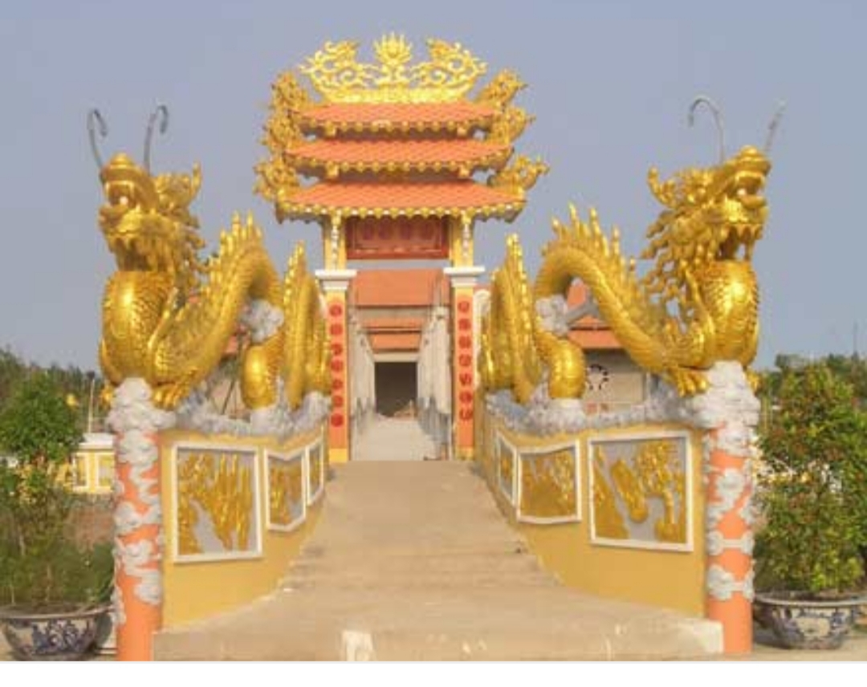
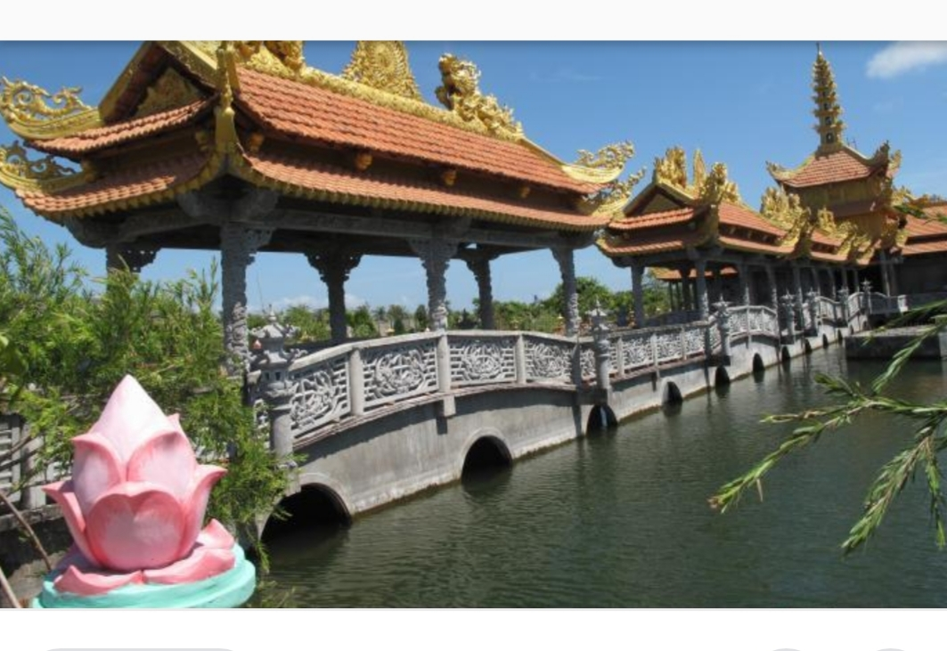
A: Where will we go?
A: How will we get there?
B: We will go to Van Phuoc pagoda.
B: By bus.
A: When will we go?
A: What will we take?
B: we will go this Sunday.
B: We will take a camera, some food, bottled water and caps.
A: Who will we go with?
A: What will we do?
B: We will go with our classmates.
B: We will visit around the pagoda,
take photos and pray for good things.

